Slide 1
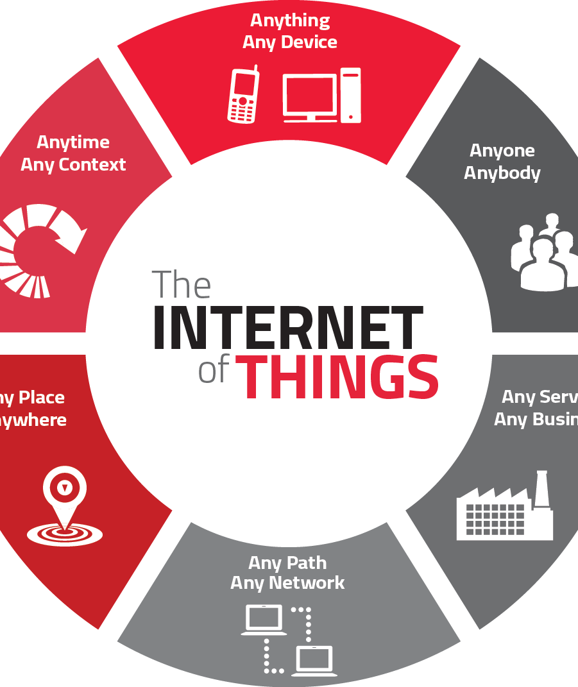
Cybersecurity challenges in the Expanding IOT landscape
-Pratik Dahal
This Photo by Unknown Author is licensed under CC BY-SA

Slide 2
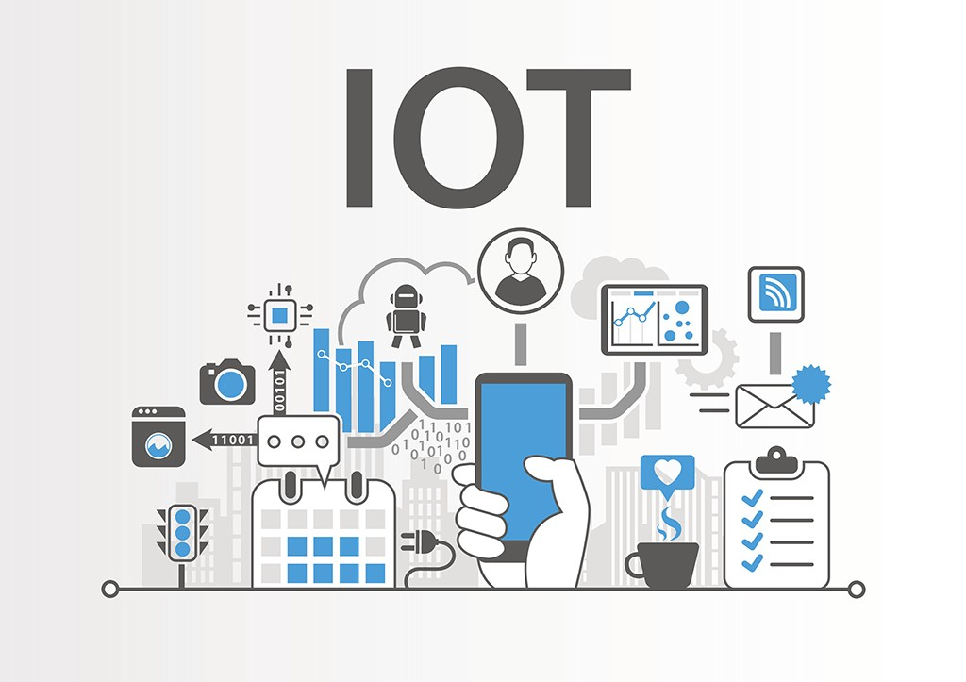
INTRODUCTION TO IOT
IoT connects everyday devices to the internet, transforming them into 'smart' devices. This interconnectivity offers enhanced automation and data collection across various sectors
This Photo by Unknown Author is licensed under CC BY-SA-NC

Slide 3
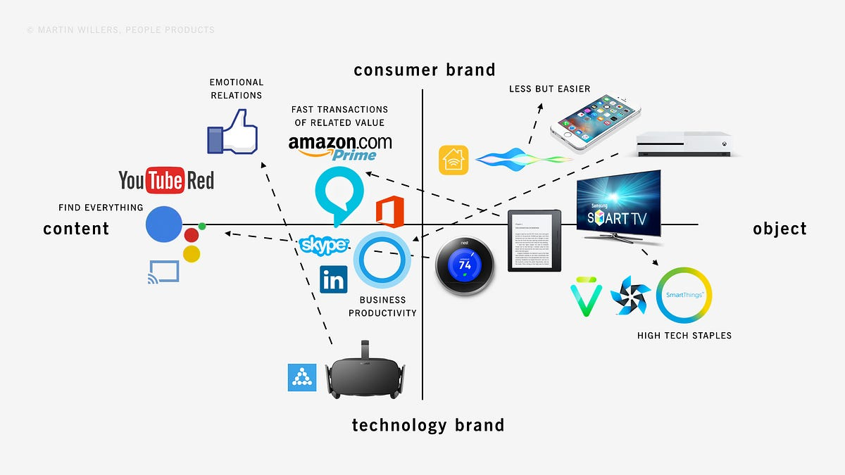
IoT Ecosystem
IoT's ecosystem includes smart gadgets like thermostats and watches, sensors for data collection, processors for computation, and technologies for communication among devices.
This Photo by Unknown Author is licensed under CC BY

Slide 4
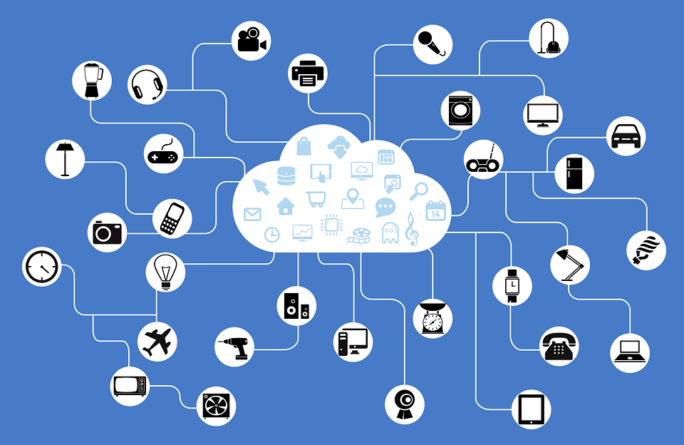
Networks Connecting IoT Devices
IoT devices are connected through networks ranging from small local networks in homes to vast global networks, enabling wide-reaching communication and control.
This Photo by Unknown Author is licensed under CC BY

Slide 5
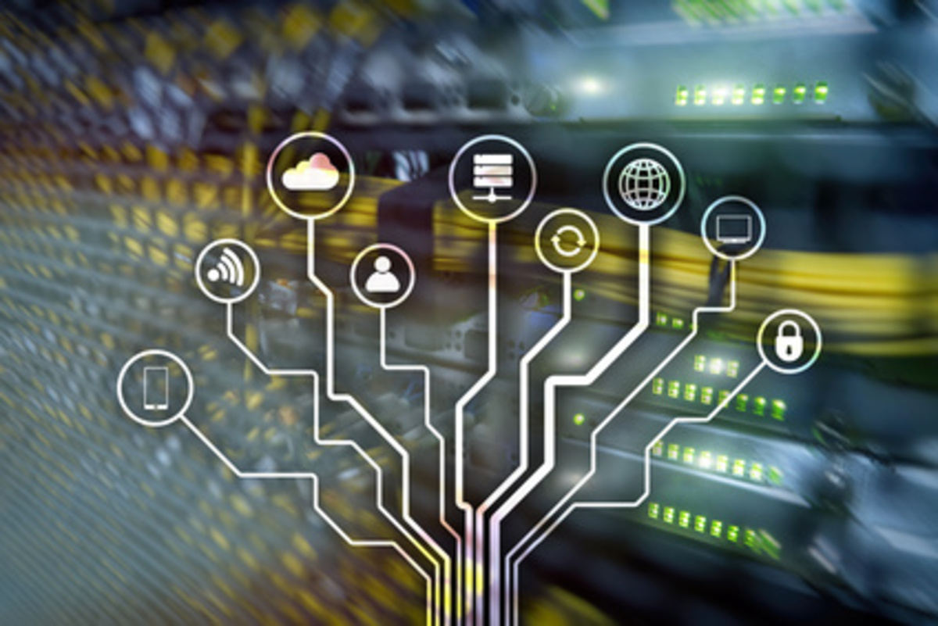
Cybersecurity Risks Overview
IoT faces cybersecurity threats like hacking and data breaches, due to its internet connectivity and vast data collection.
This Photo by Unknown Author is licensed under CC BY

Slide 6
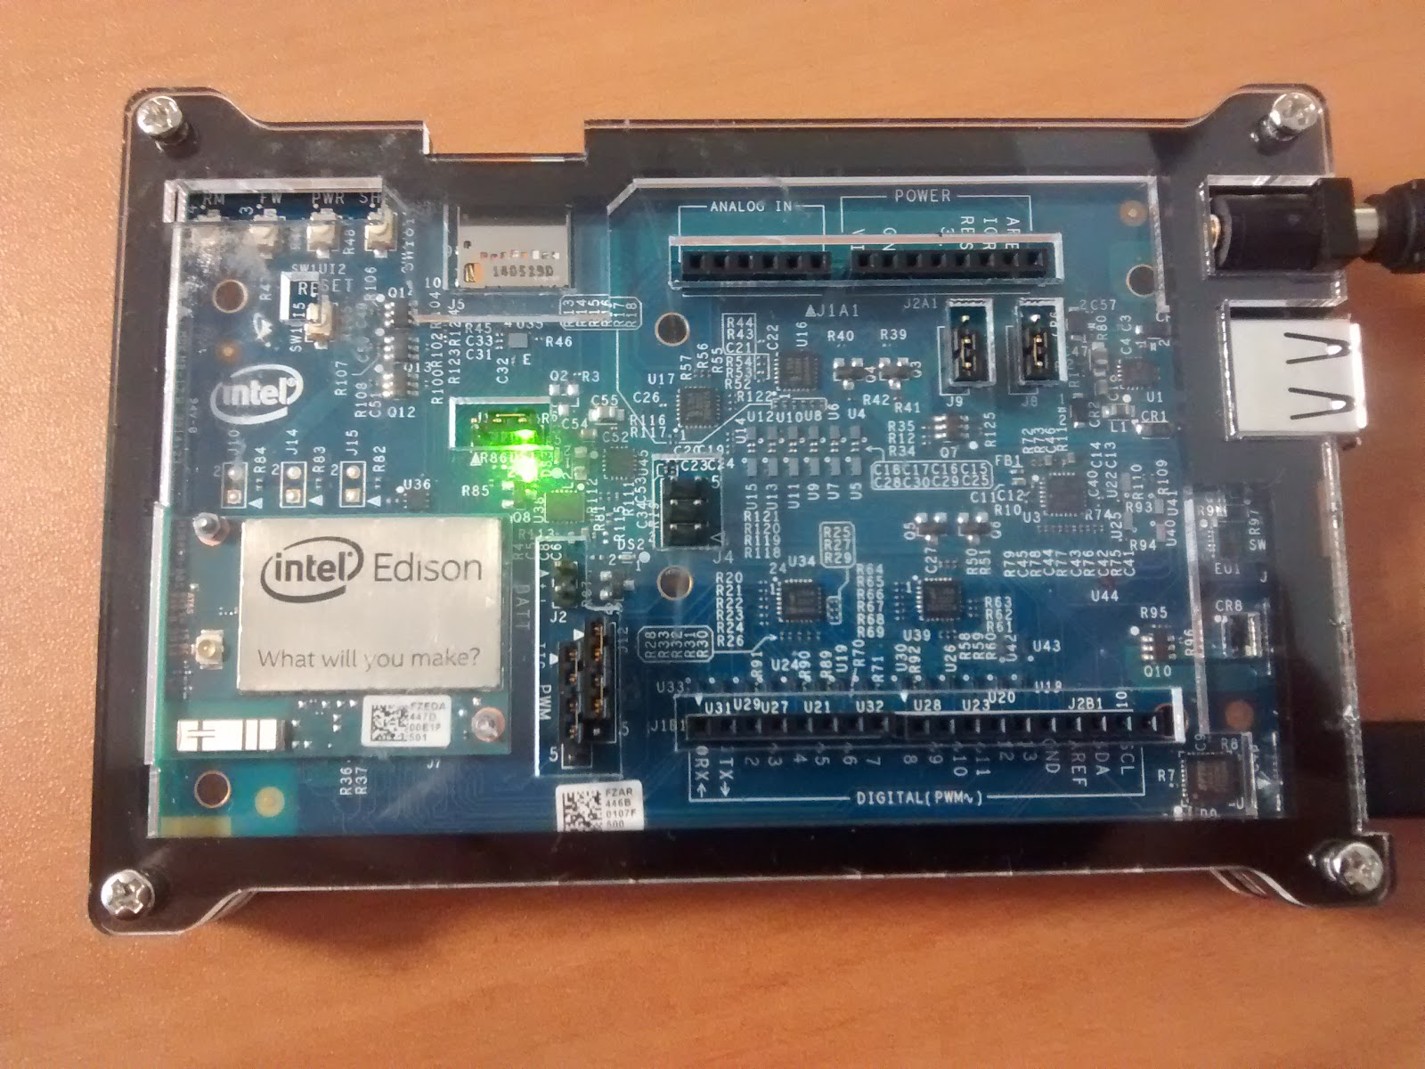
Firmware Vulnerabilities in IoT
Weaknesses in device firmware can be exploited for unauthorized access or control, posing significant security risks.
This Photo by Unknown Author is licensed under CC BY-SA
This Photo by Unknown Author is licensed under CC BY

Slide 7

Data Transmission Security in IoT
Transmitting data over wireless networks opens up risks of interception and unauthorized access, challenging IoT security.
This Photo by Unknown Author is licensed under CC BY-SA

Slide 8
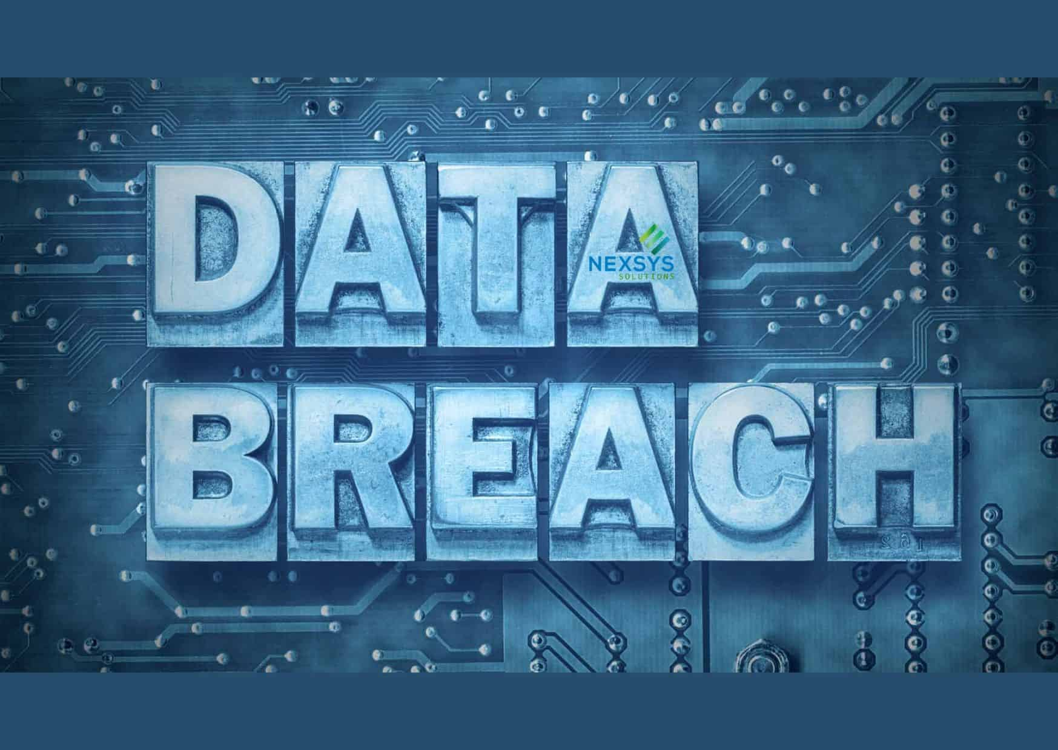
Data Processing and Analytics Risks
IoT devices processing large amounts of data can have vulnerabilities in their analytics capabilities, potentially leading to security breaches.
This Photo by Unknown Author is licensed under CC BY-ND

Slide 9
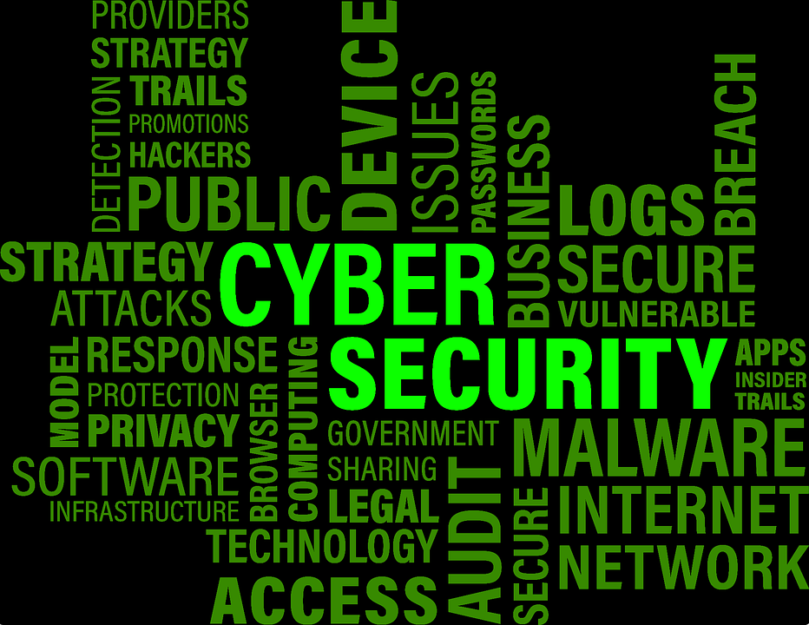
Unique Security Challenges in IoT
IoT's diverse devices and their differing capabilities create unique security challenges, complicating integration of consistent security measures.
This Photo by Unknown Author is licensed under CC BY

Slide 10
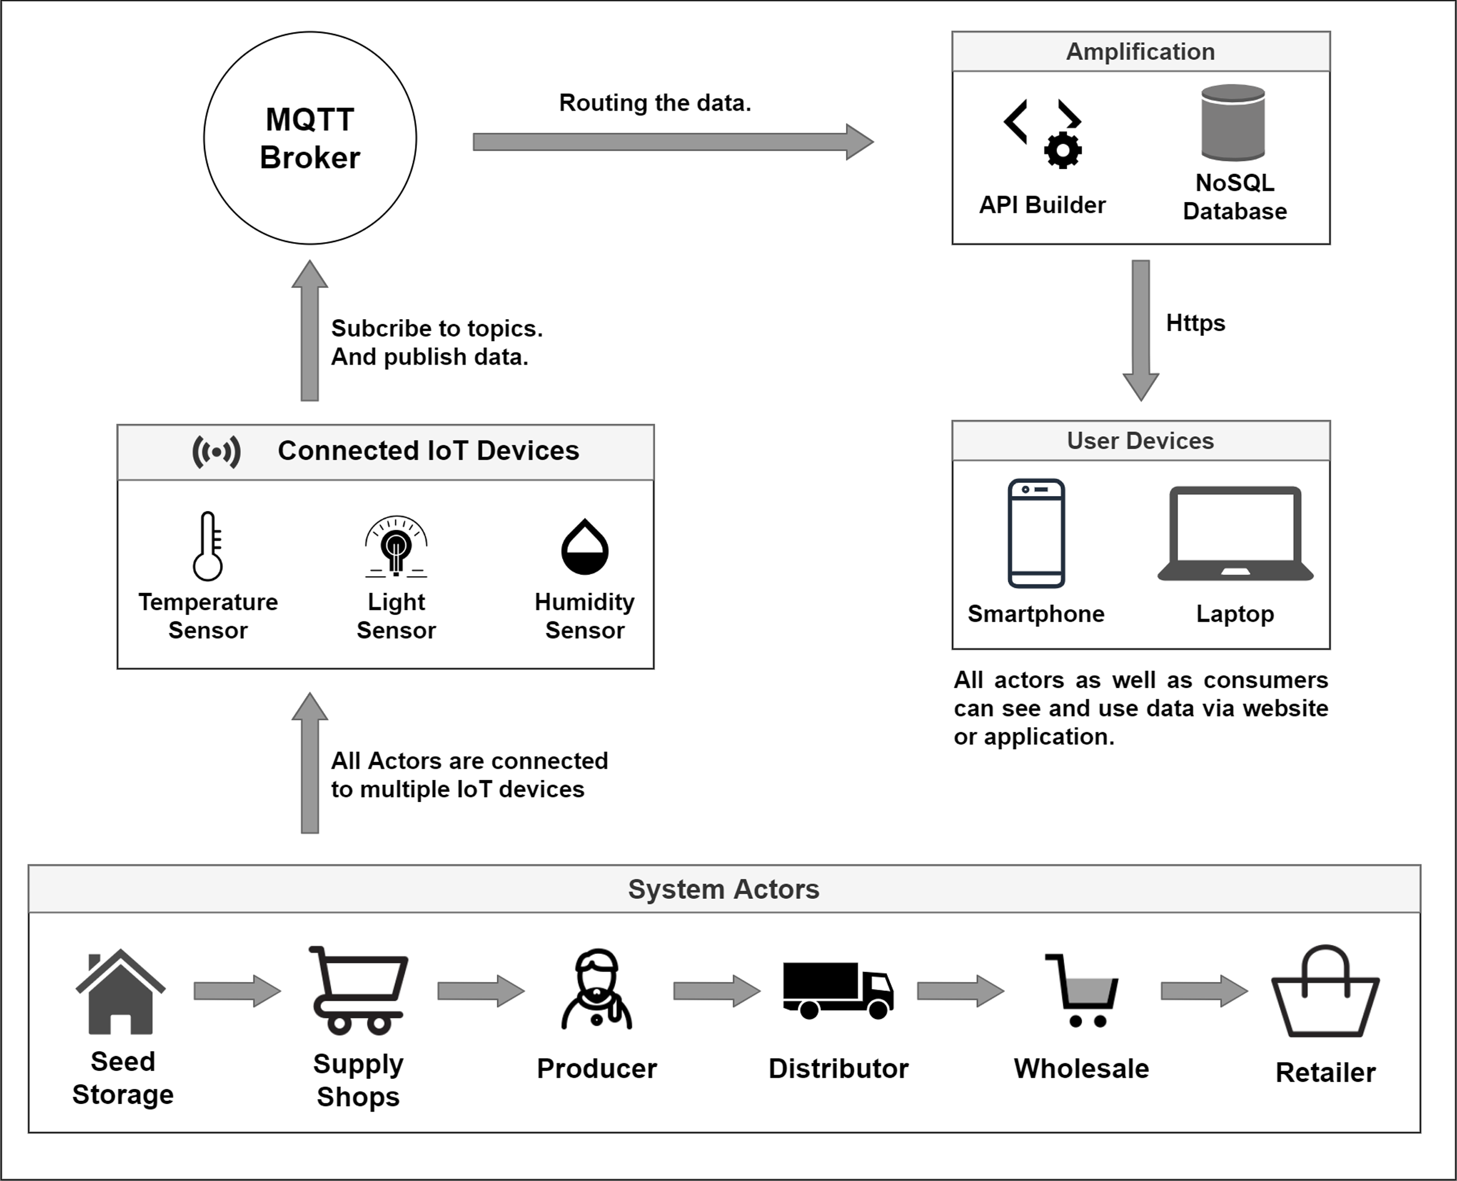
Complexity and Integration Issues
Integrating IoT with legacy systems and managing decentralized architectures adds complexity and poses security risks.
This Photo by Unknown Author is licensed under CC BY

Slide 11
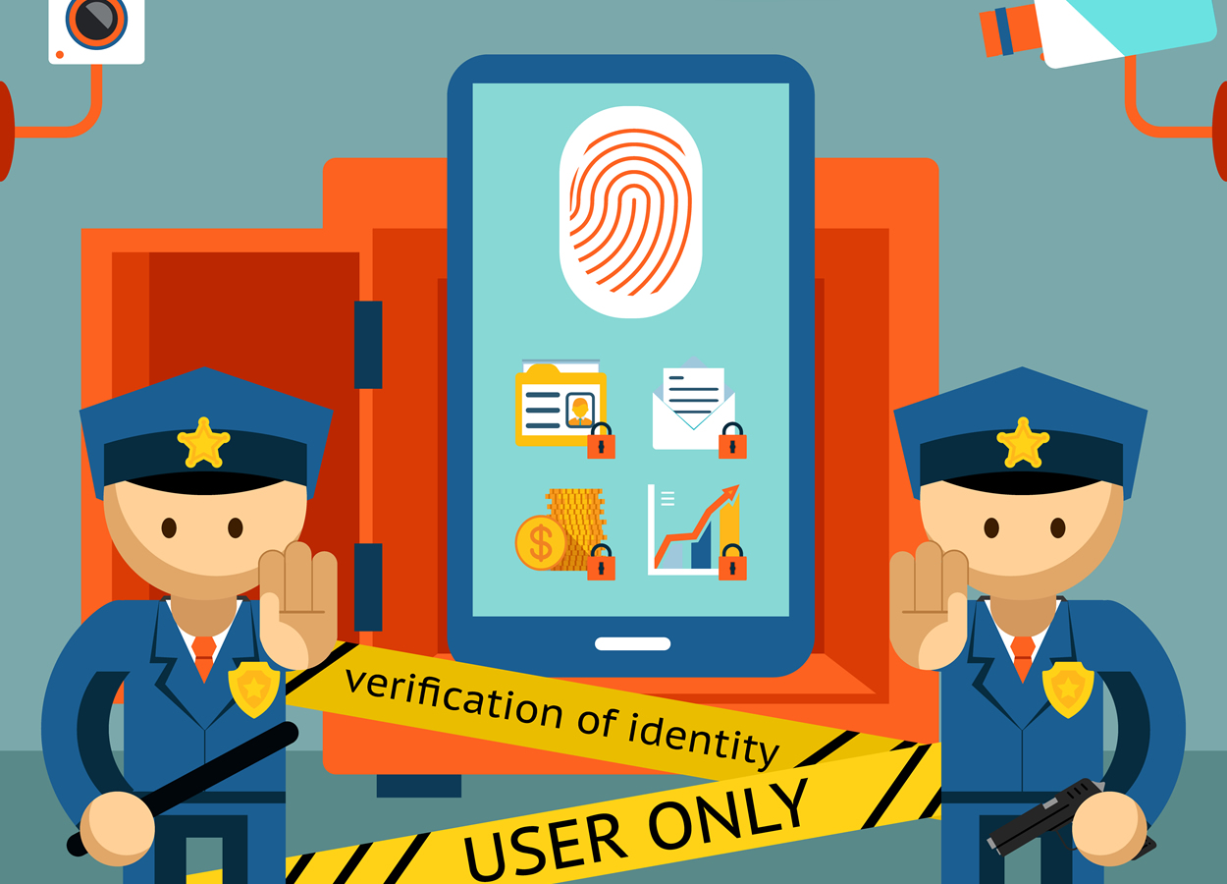
Data Privacy in IoT
IoT's extensive data collection raises concerns about privacy and the potential misuse of personal information.
This Photo by Unknown Author is licensed under CC BY

Slide 12
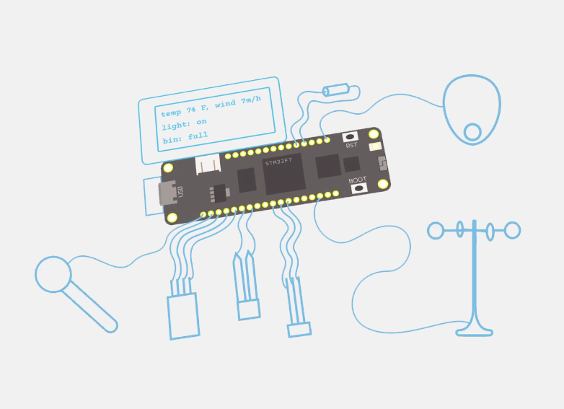
Standardization and Regulation Needs
There's a need for standard protocols and regulatory frameworks to ensure secure and reliable IoT operations
This Photo by Unknown Author is licensed under CC BY-SA

Slide 13

Solutions and Best Practices
Encryption: Implementing advanced encryption is crucial for securing data in the IoT ecosystem.
This Photo by Unknown Author is licensed under CC BY-SA

Slide 14

Software Updates and Patches
Regular software updates and patches are essential to protect IoT devices from emerging security threats.

Slide 15
Security by Design in IoT
Integrating security features from the initial design phase is vital for creating inherently secure IoT devices.

Slide 16
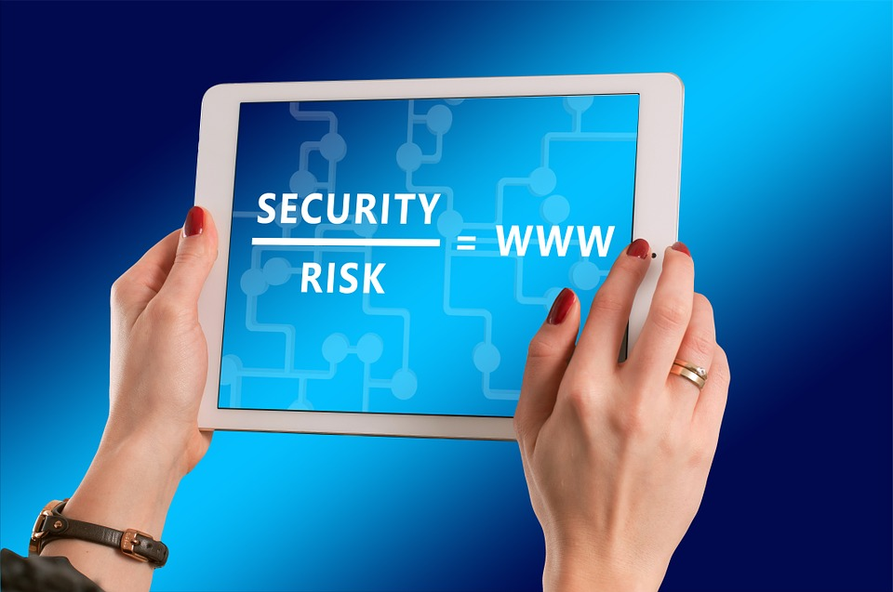
Access Control and Authentication
Proper access control and authentication mechanisms are key to ensuring only authorized access to IoT devices and data.
This Photo by Unknown Author is licensed under CC BY-SA

Slide 17

Future Trends
AI and Machine Learning in IoT Security: AI and machine learning are being increasingly used for predictive security analysis and real-time threat response in IoT.

Slide 18
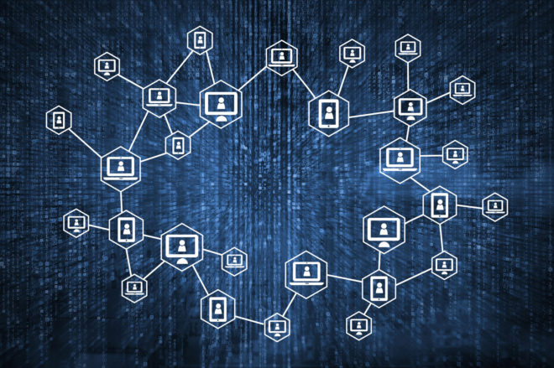
Blockchain for IoT Security
Blockchain offers decentralized data management, enhancing security and integrity in IoT device communication.
This Photo by Unknown Author is licensed under CC BY

Slide 19

Advances in Encryption Technology
Balancing the need for robust security with efficient resource use is driving advances in encryption technologies for IoT.
This Photo by Unknown Author is licensed under CC BY-NC-ND

Slide 20

Thank You
This Photo by Unknown Author is licensed under CC BY-ND

